Slide 1
Regular Languages and Regular Grammars
1

Slide 2
Regular Expressions
RE is a notation of describing a language.
Recursive definition
Let Σ be an alphabet. Then, ∅, λ, a∈Σ are regular expressions.
If r₁ and r₂ are regular expressions, so are r₁+r₂, r₁r₂, (r₁), r₁*.
2

Slide 3
Languages associated with R.E.
The language L(r) denoted (defined) by r is:
– ∅
– λ
– a
– L(r₁+r₂)
– L(r₁r₂)
– L((r₁))
– L(r₁*)
3

Slide 4
Examples
L(a)
– L(a*)
L(a+ab)
– L(a* (a+b))
– L((a+b)* (a+bb))
– L((aa)* (bb)* b)
4

Slide 5
Design R.E. for languages
L={w∈{a,b}* : w starts with a and ends with b}
Ans: a.(a+b)*.b
L={w∈{a,b}* : w contains substring aba}
Ans: (a+b)*.aba.(a+b)*
L={w∈{a,b}* : w does not end in aba}
Ans: ((a+b)*(aaa+aab+abb+baa+bab+bba+bbb))|(a+b+ε)(a+b+ε)

Slide 6
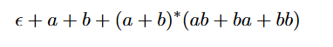

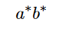
L={w∈{a,b}* : All strings that do not end with aa}
Ans:
L={w∈{a,b}* : strings that contain an even number of b’s.
Ans:
L={w∈{a,b}* : strings which do not contain the substring ba.
Ans:

Slide 7
Simplification of R.E.
(r*)* = r*
r₁*(r₁ + r₂)* = (r₁+r₂)*
r₁(r₂+r₃)= r₁r₂+r₁r₃
r₁∅= ∅
r+∅= r
∅*=λ
7

Slide 8
Connection between regular expressions and regular languages
Regular expressions
=
Finite Automata (DFA, NFA, ε-NFA)
Syntactical expressions
Automata/machines
Regular Languages
Formal language classes
8

Slide 9
Finite Automata (FA) & Regular Expressions (R.E)
To show that they are interchangeable, consider the following theorems:
Theorem 1: For every DFA (M)there exists a regular expression R such that L(R)=L(M)
Theorem 2: For every regular expression R there exists an ε -NFA (M) such that L(M)=L(R)
ε -NFA
NFA
Kleene Theorem
Theorem 2
Reg Ex
DFA
Theorem 1

Slide 10
DFA
Reg Ex
Theorem 1
DFA to RE construction
Informally, trace all distinct paths (traversing cycles only once) from the start state to each of the final states and enumerate all the expressions along the way
Example:
1
0
0,1
q₀
0
q₁
1
q₂
(1*)
0
(0*)
1
(0 + 1)*
1*
00*
1
(0+1)*
Q) What is the language?
1*00*1(0+1)*
10

Slide 11
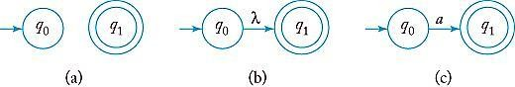
R.E. (R) ➔ NFA(M)
Use the recursion property of R.E.
(a) nfa accepts ∅. (b) nfa accepts {λ}. (c) nfa accepts {a}.

Slide 12
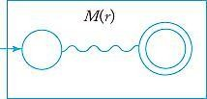
Schematic representation of an nfa accepting L(r).

Slide 13
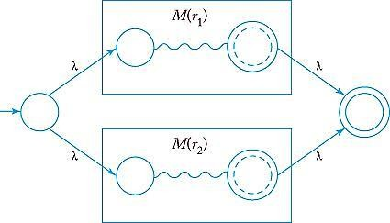
Automaton for L(r₁ + r₂).

Slide 14
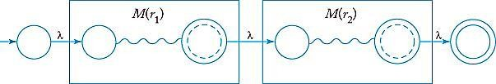
Automaton for L(r₁ r₂).

Slide 15
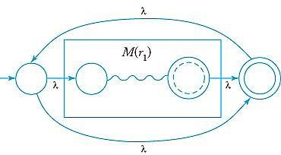
Automaton for L(r ₁* ).

Slide 16
RE to ε-NFA construction
Reg Ex
ε -NFA
Theorem 2
Example:
(0+1)*01(0+1)*
(0+1)*
01
(0+1)*
ε
ε
ε
0
ε
ε
0
ε
ε
0
1
ε
1
ε
ε
1
ε
ε
ε
16

Slide 17
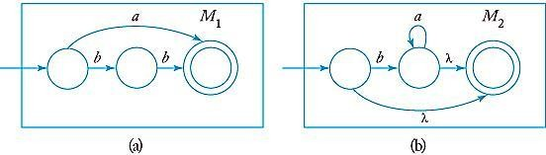
Example
Find an NFA that accepts L(r) , where r=L ((a + bb)∗ (ba∗ + λ))
(a) M₁ accepts L (a + bb). (b) M₂ accepts L (ba∗ + λ).

Slide 18
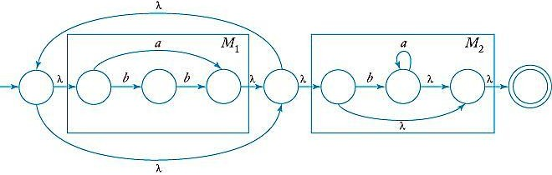
NFA for L ((a + bb)∗ (ba∗ + λ)) after applying Thomson’s rule

Slide 19
Algorithm NFA to RE
Input: NFA (M)
Start with an NFA with Q={q₀, q₁,…, q_{n}} and a final state q≠q₀
Convert the NFA to a complete GTG. Let r_{ij} be the label from q_{i} to q_{j}
If the GTG has only two states, construct the regular expression directly.
If the GTG has three states (q_{i}: initial, q_{j}: final, q_{k:} to be removed),
Add labels r_{pq}+r_{pk}r_{kk}*r_{kq} for p=i, j and q=i, j
Remove q_{k} from the GTG

Slide 20
Whenever the GTG has 4 or more states, pick a state q_{k} to be removed.
For every (q_{i}, q_{j,} q_{k}), i≠k, j≠k, do step 4.
Repeat steps (3)-(5) until a regular expression is obtained.
Note: do as much simplification as possible
r+∅ = r
r∅ = ∅
∅*= λ

Slide 21
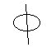
Complete GTG
A complete GTG is a graph in which all edges are present.
If a GTG, after conversion from an NFA has some edges missing, put them in and label them with
A complete GTG with |v| vertices has exactly |v|² edges

Slide 22
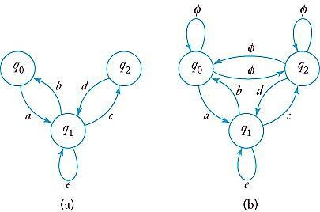
Complete GTG
– Every edge is lablled.
NFA

Slide 23
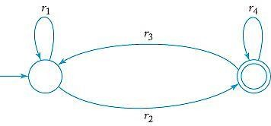
Simple two-state GTG ➔ R.E.
One is the initial state (non-final) and the other is a final state
r = r₁*r₂ (r₄+r₃r₁*r₂)*

Slide 24
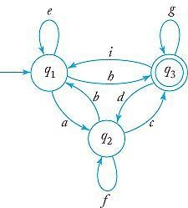
Three state GTG ➔ R.E.
Remove one state from GTG
Example,
remove q₂
Add an edge q₁→q₁
Labeled e+af*b
Add an edge q₁→q₃
Labeled h+af*c
Add an edge q₃→q₁
Labeled i+df*b
Add an edge q₃→q₃
Labeled g+df*c

Slide 25
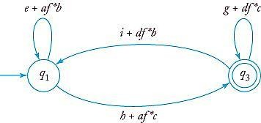

Slide 26
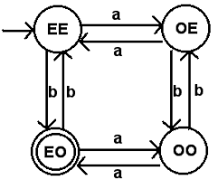
Example : Find the RE for the following Automata

Slide 27
GTG for the given Automata
EE → Initial state
EO → Final state
OE,OO → States to be removed
To Remove OE:
Add EE to OO → ab
Add OO to EE → ba
Add EE to itself → aa
Add OO to itself → bb

Slide 28
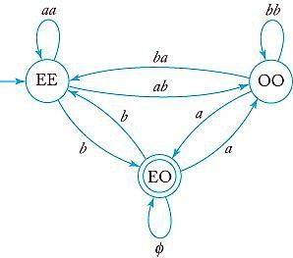
After removing OE :
To remove OO:
Add EE to EO→ b+a(bb)*ba
Add EO to EE → b+ab(bb)*a
EE to itself → aa+ab(bb)*ba
Eo to itself → a(bb)*a

Slide 29
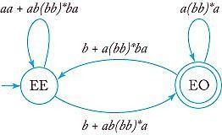
After removing OO :
RE = (aa + ab (bb)* ba)* (b+ab(bb)*a) ( (a(bb)*a) + (b+a(bb)*ba) (aa+ab(bb)* ba)* (b+ab(bb)*a) )*

